Slide 1

Python Basics

Slide 2
Camera Expectations

Slide 3

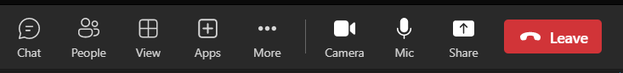

Before we start… Please have your camera switched on.
Camera Expectations
This is a mandatory requirement for the duration of the course.
You are studying a regulated qualification, your tutor needs to see that it is the right person participating throughout the course.
Our job is to prepare you for work in an age where in almost any job there is likely to be at least some aspect of remote engagement with your employer.
Online learning is to be treated the same way as a classroom learning, you must be physically visible to interact with your tutor and other learners in order to create an engaging group dynamic.

Slide 4


Background filters
If you do not wish to have your camera displaying your personal environment, Microsoft Teams has a solution to this problem…
Step One: Before you join a Teams video call, click the ‘Background Filters’ option.
Step Two: On the right-hand side, you can select any of the stock images.
Step Three: The image you choose will then appear in your background on the video call.
If you need any further support in regards to this requirement, please speak to your tutor directly.

Slide 5
Objectives
What is Python?
Review of Tools and “Hello World”
What is an Algorithm?
Data Types in Python
Assigning a Variable in Python

Slide 6

What is Python?
Bootcamp
Notes:
Official summary: https://www.python.org/doc/essays/blurb/
Image source: https://www.python.org/static/img/python-logo@2x.png

Slide 7
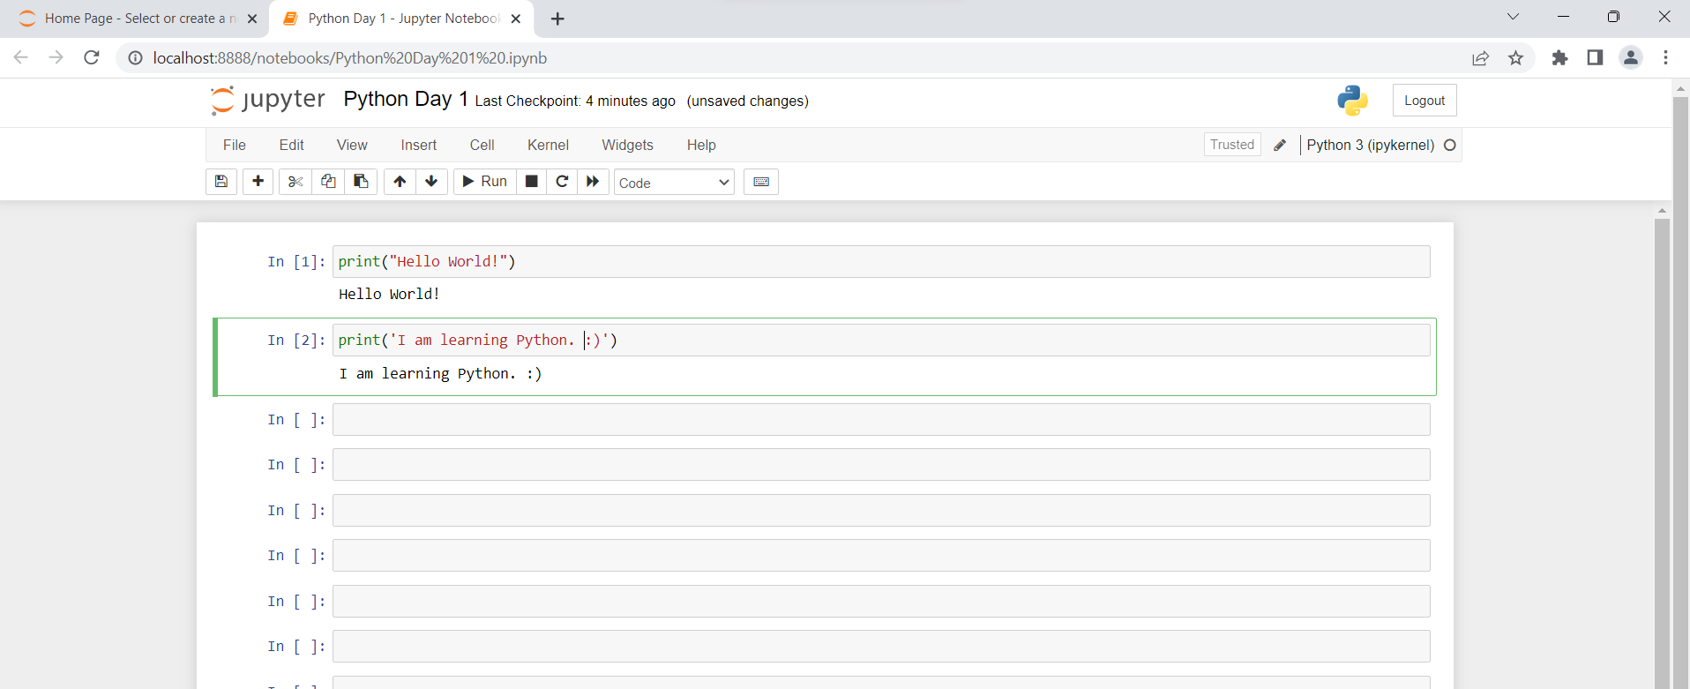
First Time Coding
Bootcamp
Open a Jupyter notebook

Slide 8
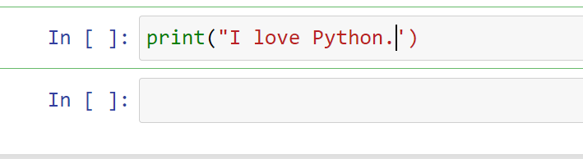
Question Time
Bootcamp
What is the output?

Slide 9
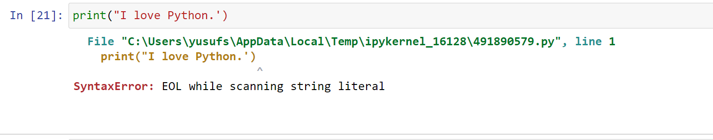
Answer
Bootcamp
This code will give you an error.

Slide 10
Question Time
Bootcamp
How can you send a message to the screen in Python?
Using display() command.
Using print() command.
Using show() command.

Slide 11
Answer
Bootcamp
How can you display a message to the screen in Python?
Using display() command.
Using print() command.
Using show() command.

Slide 12
Python escape characters
Bootcamp
print("The itsy bitsy spider\nclimbed up the waterspout.")
print()
print("Down came the rain\nand washed the spider out.")
The backslash (\) has a very special meaning when used inside strings ‒ this is called the escape character.
The letter n placed after the backslash comes from the word newline.
Both the backslash and the n form a special symbol named a newline character, which urges the console to start a new output line.

Slide 13
Python escape characters
Bootcamp
1. This convention has two important consequences:
If you want to put just one backslash inside a string, don't forget its escaping nature ‒ you have to double it. For example, an invocation like this will cause an error:
print("\")
While this one won't. Python will view it as a backslash:
print("\\")
Notes:
https://www.w3schools.com/python/gloss_python_escape_characters.asp

Slide 14
Python escape characters
Bootcamp
2. Not all escape pairs (the backslash coupled with another character) mean something.
Experiment with your code in the editor, run it, and see what happens.
print("The itsy bitsy spider\nclimbed up the waterspout.")
print()
print("Down came the rain\nand washed the spider out.")
print("The itsy bitsy spider\\nclimbed up the waterspout.")
print()
print("Down came the rain\\nand washed the spider out.")

Slide 15
Python escape and newline characters
Bootcamp
Other escape characters used in Python:
Code | Result
\' | Single Quote
\\ | Backslash
\n | New Line
\r | Carriage Return
\t | Tab
\b | Backspace
Practice Link

Slide 16
Using multiple arguments
Bootcamp
So far, we have tested the print() function behavior with no arguments, and with one argument. It's also worth trying to feed the print() function with more than one argument.
print("The itsy bitsy spider" , "climbed up" , "the waterspout.")
There is one print() function invocation, but it contains three arguments. All of them are strings.
The arguments are separated by commas. We've surrounded them with spaces to make them more visible, but it's not necessary, and we won't be doing it anymore.

Slide 17
Using multiple arguments
Bootcamp
print("The itsy bitsy spider" , "climbed up" , "the waterspout.")
print("The itsy bitsy spider" + "climbed up" + "the waterspout.")
Difference?

Slide 18
Positional arguments
Bootcamp
Now that you know a bit about print() function customs, we're going to show you how to change them.
print("My name is", "Python.")
print("Monty Python.")
The way in which we are passing the arguments into the print() function is the most common in Python and is called the positional way. This name comes from the fact that the meaning of the argument is dictated by its position (e.g., the second argument will be outputted after the first, not the other way round).

Slide 19
Keyword arguments
Bootcamp
Python offers another mechanism for the passing of arguments, which can be helpful when you want to convince the print() function to change its behavior a bit.
We aren't going to explain it in depth right now. We plan to do this when we talk about functions. For now, we simply want to show you how it works. Feel free to use it in your own programs.
The mechanism is called keyword arguments. The name stems from the fact that the meaning of these arguments is taken not from its location (position) but from the special word (keyword) used to identify them.

Slide 20
Keyword arguments
Bootcamp
The print() function has two keyword arguments that you can use for your purposes. The first is called end.
print("My name is", "Python.", end=" ")
print("Monty Python.")

Slide 21
Keyword arguments
Bootcamp
In order to use it, it is necessary to know some rules:
a keyword argument consists of three elements: a keyword identifying the argument (end here); an equal sign (=); and a value assigned to that argument;
any keyword arguments must be put after the last positional argument (this is very important)
In our example, we have made use of the end keyword argument, and set it to a string containing one space.

Slide 22
Keyword arguments
Bootcamp
The default behavior reflects the situation where the end keyword argument is implicitly used in the following way: end="\n".
If you look carefully, you'll see that we've used the end argument, but the string assigned to it is empty (it contains no characters at all).
What will happen now?
print("My name is ", end="")
print("Monty Python.")

Slide 23
Keyword arguments
Bootcamp
We said previously that the print() function separates its outputted arguments with spaces. This behavior can be changed, too.
The keyword argument that can do this is named sep (as in separator).
print("My", "name", "is", "Monty", "Python.", sep="-")
Note: the sep argument's value may be an empty string, too. Try it for yourself.

Slide 24
Keyword arguments
Bootcamp
print("My", "name", "is", sep="_", end="*")
print("Monty", "Python.", sep="*", end="*\n")

Slide 25
Exercise
Bootcamp
print("Programming","Essentials","in")
print("Python")
Modify above code to get following output.
Programming***Essentials***in...
Python
Notes:
print("Programming","Essentials","in", sep="***", end="...")
print("Python")

Slide 26
Python Arithmetic Operators
Bootcamp
Arithmetic operators are used with numeric values to perform common mathematical operations:
Operator | Name | Example | Try it
+ | Addition | x + y | Try it »
- | Subtraction | x - y | Try it »
* | Multiplication | x * y | Try it »
/ | Division | x / y | Try it »
% | Modulus | x % y | Try it »
** | Exponentiation | x ** y | Try it »
// | Floor division | x // y | Try it »
Notes:
https://www.w3schools.com/python/gloss_python_arithmetic_operators.asp

Slide 27
Exercises
Bootcamp
print(30+5)
print(30/5)
print(30*/5)
print(33%5)
print(30//5)

Slide 28
Steps for Problem Solving
Bootcamp
Following are Steps for Problem Solving:
Analysing the Problem
Developing an Algorithm
Coding
Testing and Debugging

Slide 29
Algorithm
Bootcamp
Problem − Design an algorithm to add two numbers and display the result.
Step 1: Start
Step 2: Declare variables num1, num2 and sum.
Step 3: Read values for num1, num2.
Step 4: Add num1 and num2 and assign the result to a variable sum.
Step 5: Display sum
Step 6: Stop

Slide 30
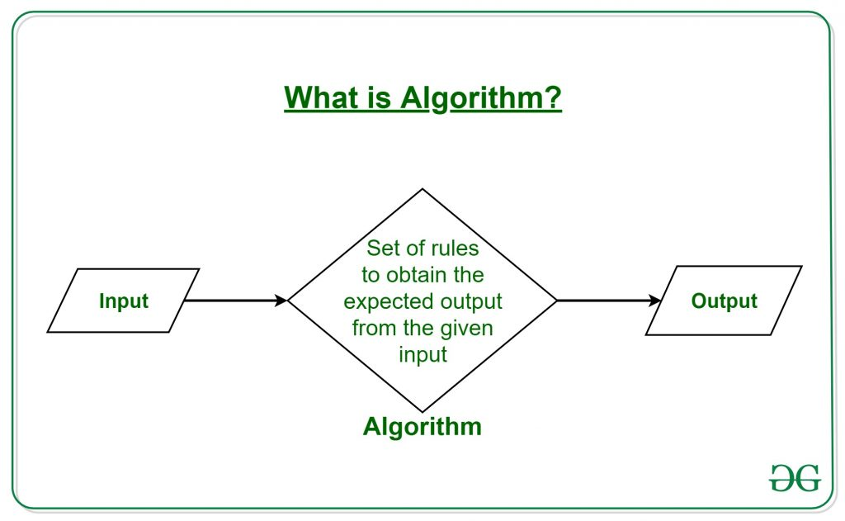
Question
What is an algorithm?
Notes:
https://www.geeksforgeeks.org/introduction-to-algorithms/

Slide 31
Comments
Bootcamp
You may want to put in a few words addressed not to Python but to humans, usually to explain to other readers of the code how the tricks used in the code work, or the meanings of the variables, and eventually, in order to keep stored information on who the author is and when the program was written.
A remark inserted into the program, which is omitted at runtime, is called a comment.

Slide 32
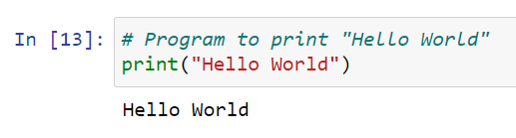
Comments
Bootcamp
Comments are used to explain code when the basic code itself isn’t clear.
# >> The “Hash” character makes lines comment.
<Comment lines are not printed.>
Notes:
https://www.programiz.com/python-programming/docstrings
If you'd like to quickly comment or uncomment multiple lines of code, select the line(s) you wish to modify and use the following keyboard shortcut: CTRL + / (Windows) or CMD + / (Mac OS). It's a very useful trick, isn't it? Now experiment with the code in the editor.

Slide 33

Variables
Bootcamp
The declaration happens automatically when you assign a value to a variable.
Structure of declaration:
variable name = value
planet = “jupyter”
price = 140
pi_number = 3.14

Slide 34
Question Time
Bootcamp
my_age = 33
your_age = 30
my_age = your_age
print(my_age)
What's the output?

Slide 35
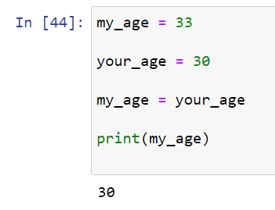
Answer
Bootcamp
Notes:
Explain how it works.

Slide 36
Data Types in Python
Bootcamp
Data Types
Python has the following data types built-in by default, in these categories:
Text Type: str
Numeric Types: int, float, complex
Sequence Types: list, tuple, range
Mapping Type: dict
Set Types: set, frozenset
Boolean Type: bool
Binary Types: bytes, bytearray
Notes:
>>> type(65)
<class 'int'>
>>> type(45.6)
<class 'float'>
>>> type("Hi!")
<class 'str'>
>>> type(True)
<class 'bool'>
>>> 1<2
True
>>> 1<1
False
>>> 1==1
True
>>> 1>=1
True

Slide 37
The PEP 8
Bootcamp
The PEP 8 -- Style Guide for Python Code recommends the following naming convention for variables and functions in Python:
variable names should be lowercase, with words separated by underscores to improve readability (e.g., var, my_variable)
function names follow the same convention as variable names (e.g., fun, my_function)
it's also possible to use mixed case (e.g., myVariable), but only in contexts where that's already the prevailing style, to retain backward compatibility with the adopted convention.

Slide 38
Keywords
Bootcamp
['False', 'None', 'True', 'and', 'as', 'assert', 'break', 'class', 'continue', 'def', 'del', 'elif', 'else', 'except', 'finally', 'for', 'from', 'global', 'if', 'import', 'in', 'is', 'lambda', 'nonlocal', 'not', 'or', 'pass', 'raise', 'return', 'try', 'while', 'with', 'yield’]
They are called keywords or (more precisely) reserved keywords. They are reserved because you mustn't use them as names: neither for your variables, nor functions, nor any other named entities you want to create.
The meaning of the reserved word is predefined and mustn't be changed in any way.
Fortunately, due to the fact that Python is case-sensitive, you can modify any of these words by changing the case of any letter, thus creating a new word, which is not reserved anymore.

Slide 39
Variables Exercise
Bootcamp
Create a variable myName and assign it value of your Name
Print it
Check the type of data of your variable
Find the length of your name

Slide 40
The input() function
Bootcamp
The input() function is able to read data entered by the user and to return the same data to the running program.
The program can manipulate the data, making the code truly interactive.
Virtually all programs read and process data. A program which doesn't get a user's input is a deaf program

Slide 41
The input() function
Bootcamp
print("Tell me anything...")
anything = input()
print("Hmm...", anything, "... Really?")

Slide 42
The input() with an argument
Bootcamp
The input() function can do something else: it can prompt the user without any help from print().
anything = input("Tell me anything...")
print("Hmm...", anything, "...Really?")

Slide 43
The input() with an argument
Bootcamp
We've said it already, but it must be unambiguously stated once again: the result of the input() function is a string.
A string containing all the characters the user enters from the keyboard. It is not an integer or a float.
This means that you mustn't use it as an argument of any arithmetic operation, e.g., you can't use this data to square it, divide it by anything, or divide anything by it.
anything = input("Enter a number: ")
something = anything ** 2.0
print(anything, "to the power of 2 is", something)

Slide 44
Casting in Python
Bootcamp
There may be times when you want to specify a type on to a variable. This can be done with casting.
c = int(1)
b = int(3.8)
c = int(“5")

Slide 45
Type casting (type conversions)
Bootcamp
Python offers two simple functions to specify a type of data and solve this problem ‒ here they are: int() and float().
Their names are self-commenting:
the int() function takes one argument (e.g., a string: int(string)) and tries to convert it into an integer; if it fails, the whole program will fail too (there is a workaround for this situation, but we'll show you this a little later);
the float() function takes one argument (e.g., a string: float(string)) and tries to convert it into a float (the rest is the same).
Notes:
This is very simple and very effective. Moreover, you can invoke any of the functions by passing the input() results directly to them. There's no need to use any variable as an intermediate storage.

Slide 46
Type casting (type conversions)
Bootcamp
anything = float(input("Enter a number: "))
something = anything ** 2.0
print(anything, "to the power of 2 is", something)

Slide 47
First Programme
Bootcamp
# This program says hello and asks for my name.
print('Hello, world!')
print('What is your name?') # ask for their name
myName = input()
print('It is good to meet you, ' + myName)
print('The length of your name is:')
print(len(myName))
print('What is your age?') # ask for their age
myAge = input()
print('You will be ' + str(int(myAge) + 1) + ' in a year.')

Slide 48
Data Types Quiz
Bootcamp
What is the data type of print(type(10)) ?
Which of the following is not a Python Data Type?
a) int b) string c) char d) set
3. Which data type can be used to store the percentage obtained by a student?
a) Boolean b) Float c) String d) Integer

